Slide 1

IUT Admission Test Management System
Team ID:
03

Slide 2
Presented By
Zahin Raidah Maisha (170042032)
Nafisa Mehjabin
(170042033)
Khandaker Rifah Tasnia (170042042)

Slide 3

About our project
How it’s better
Admission test management system takes all the steps of the entire admission test procedure into account and manages all the steps efficiently.
I am here because I love to give preseajntations.

Slide 4
REQUIRED LANGUAGES AND SOFTWARES
Programming Language : PHP
Web designing Language : HTML, CSS,JavaScript
Database Management System : MySQL
Database Hosting : Xampp
Framework: Laravel

Slide 5





FEATURES
Separate applicants scrutinization
Admin Panel
Seat Plan
Admit card download
Merit list publication

Slide 6
FUNCTIONALITY
●Separate applicant procedure for bangla and english medium
●An admin panel will have authorization to manually scrutinize and make the shortlist, along with the publication of merit list.
●The applicant cannot apply more than once
●In case the applicant forgets password, they can request for a new one.

Slide 7
TIMELINE
Laravel framework research, database design
Separating Admin
Panel, along with short list scrutinizing
Merit list and result publication
JULY
AUG
SEP
OCT
Creating Apply page, generating pin and password for applicant
Admit card
and seat plan allocation

Slide 8
FUTURE PLAN
CALL FOR ADMISSION
SUBJECT ALLOCATION
AUTO MIGRATION
ADMISSION PROCEDURE FOR INTERNATIONAL STUDENTS

Slide 9
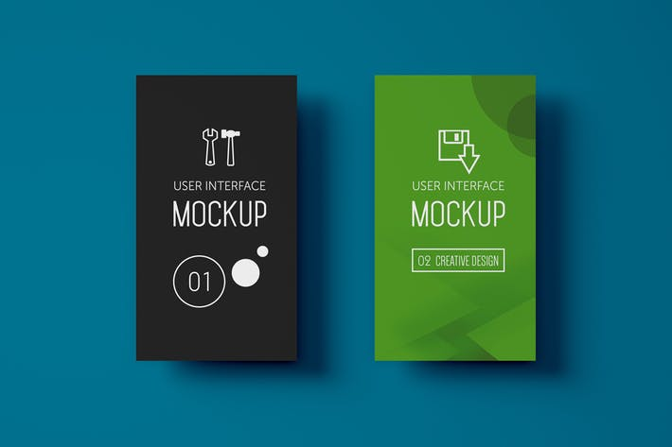
DESKT
Place your screenshot here

Slide 10
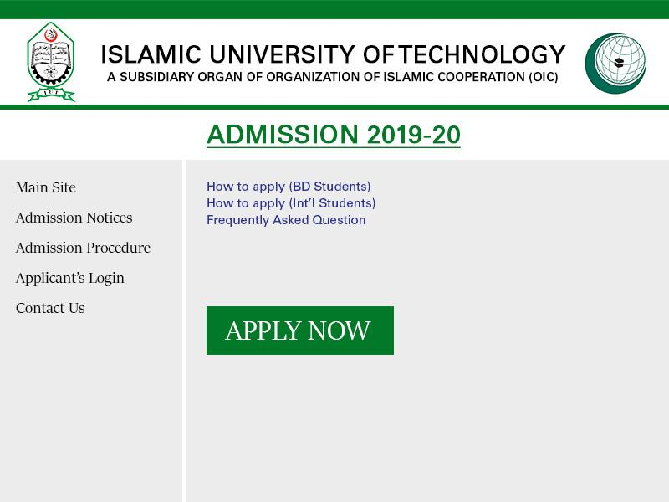

Slide 11
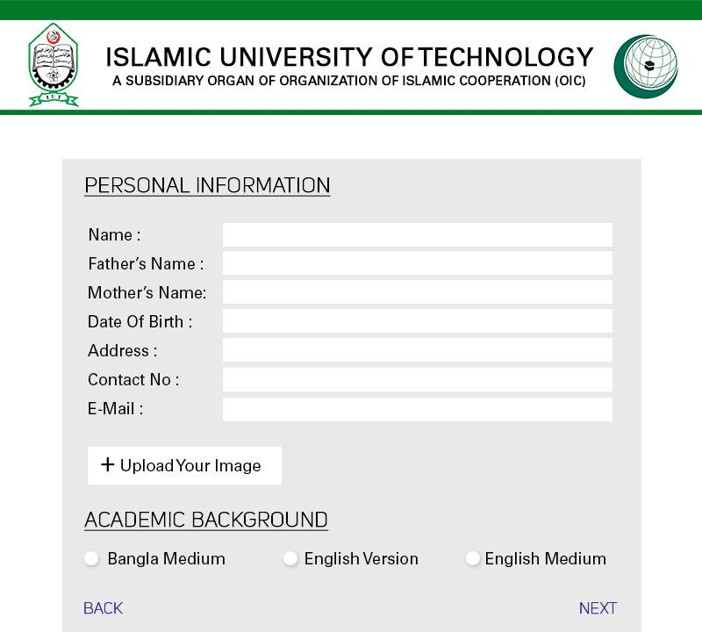
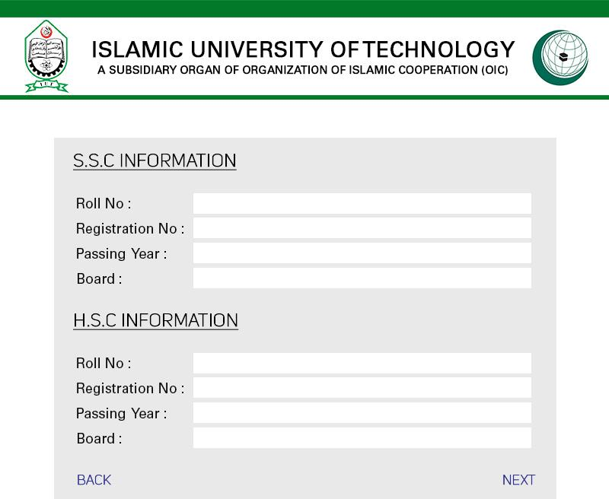

Slide 12
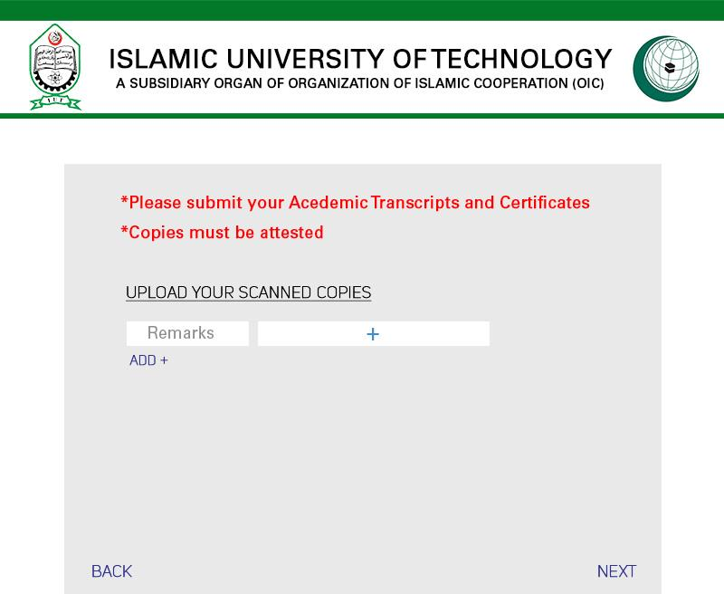

Slide 13
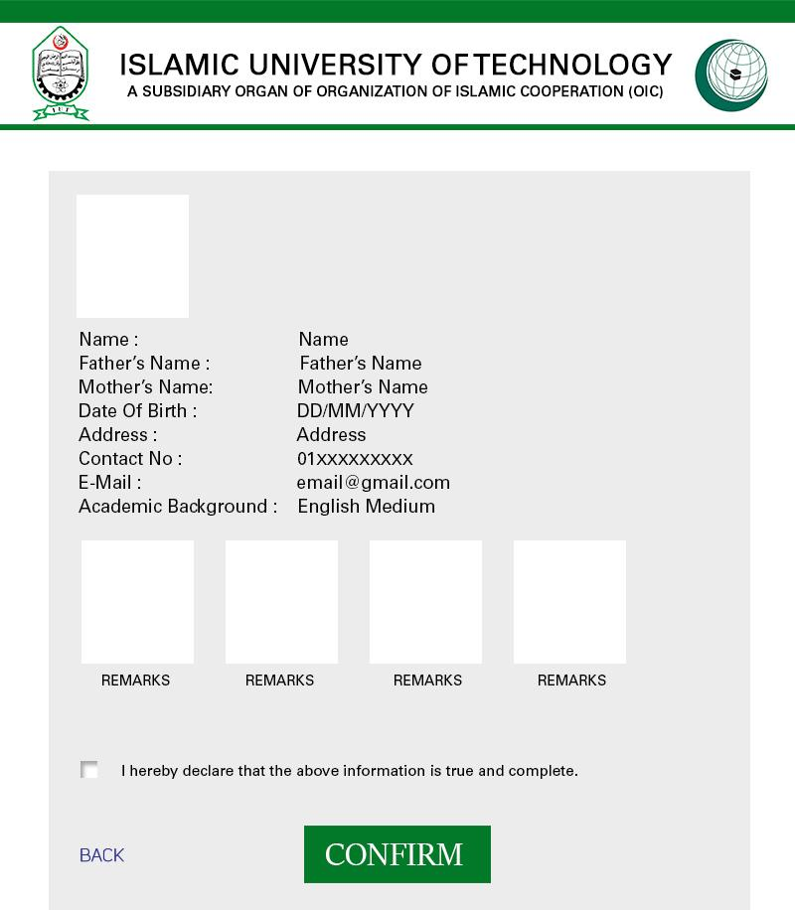
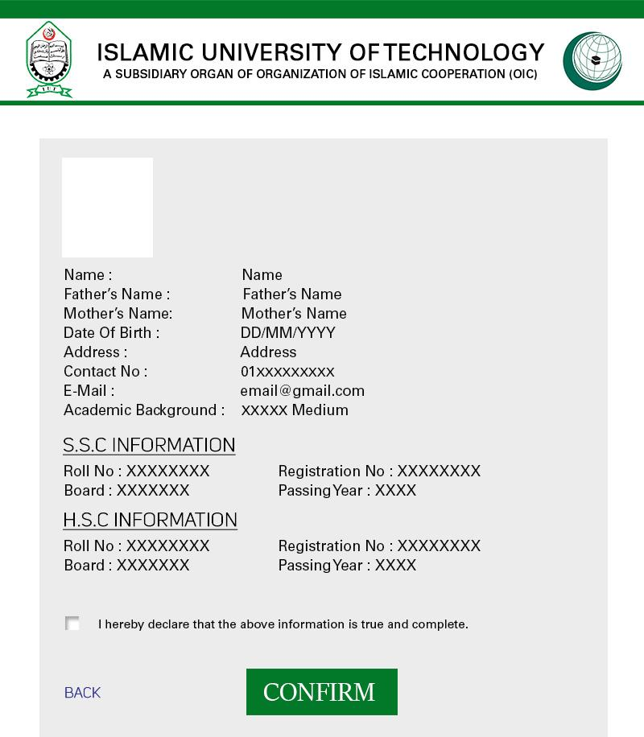

Slide 14
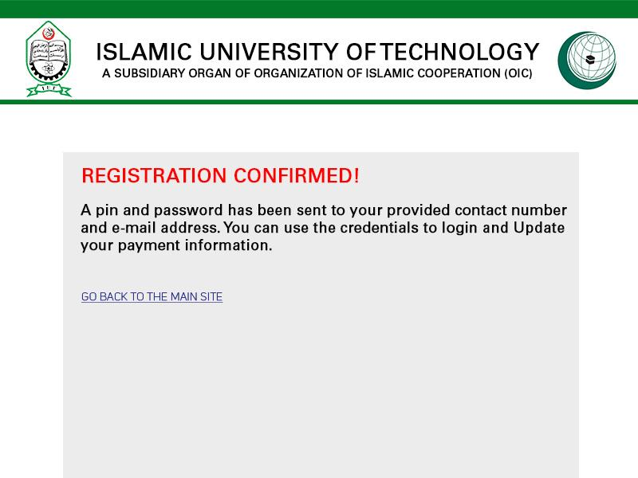

Slide 15
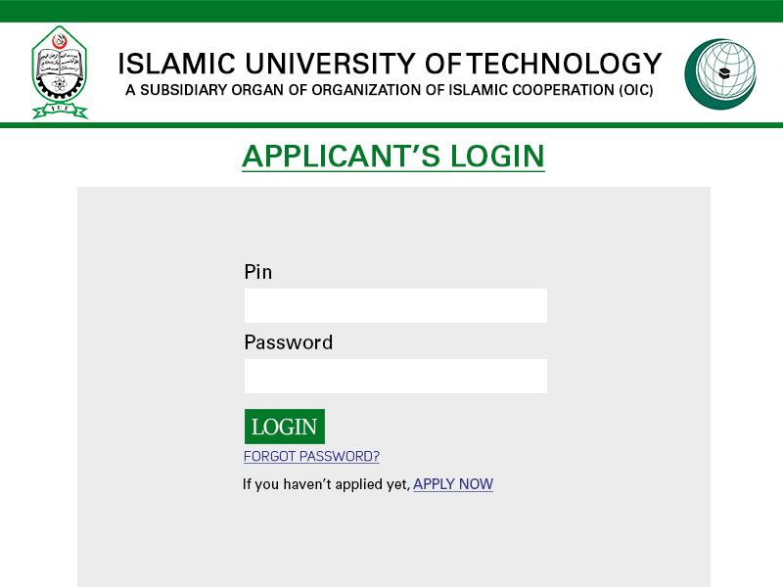

Slide 16
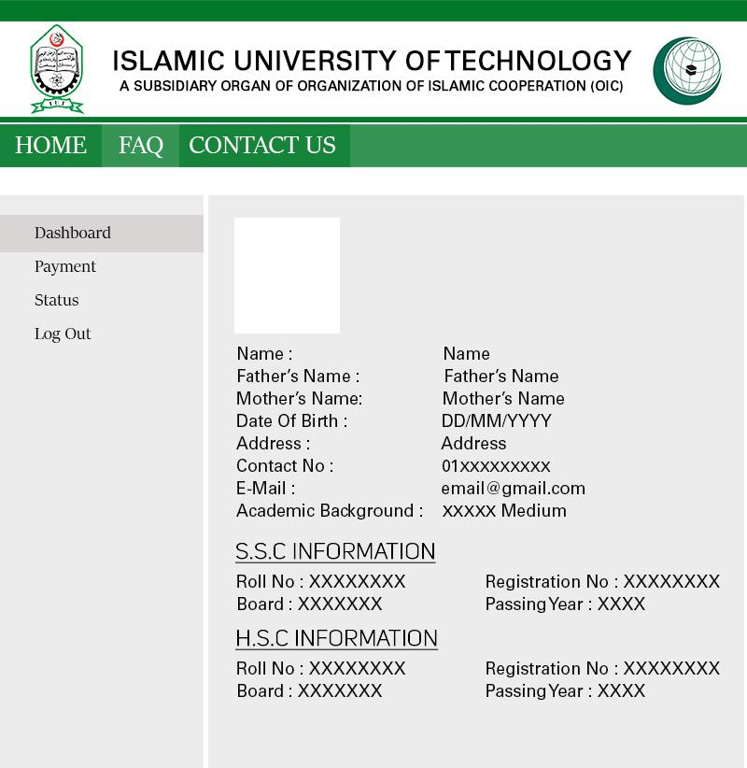
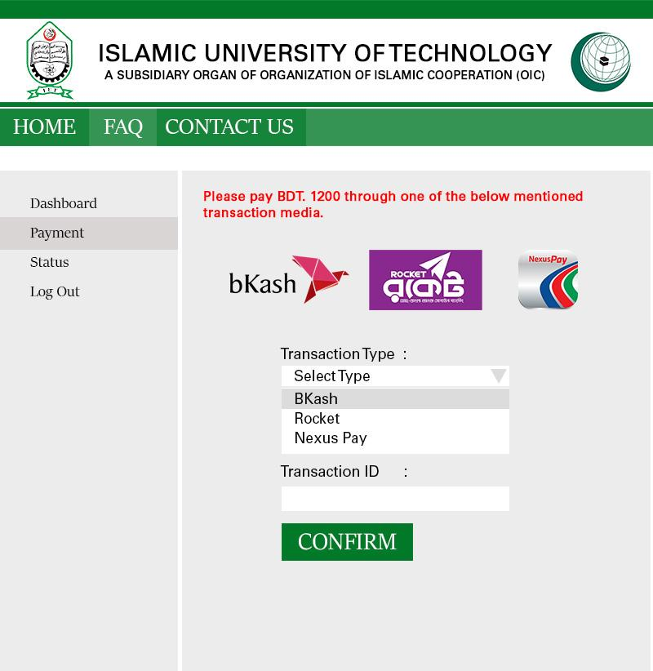

Slide 17
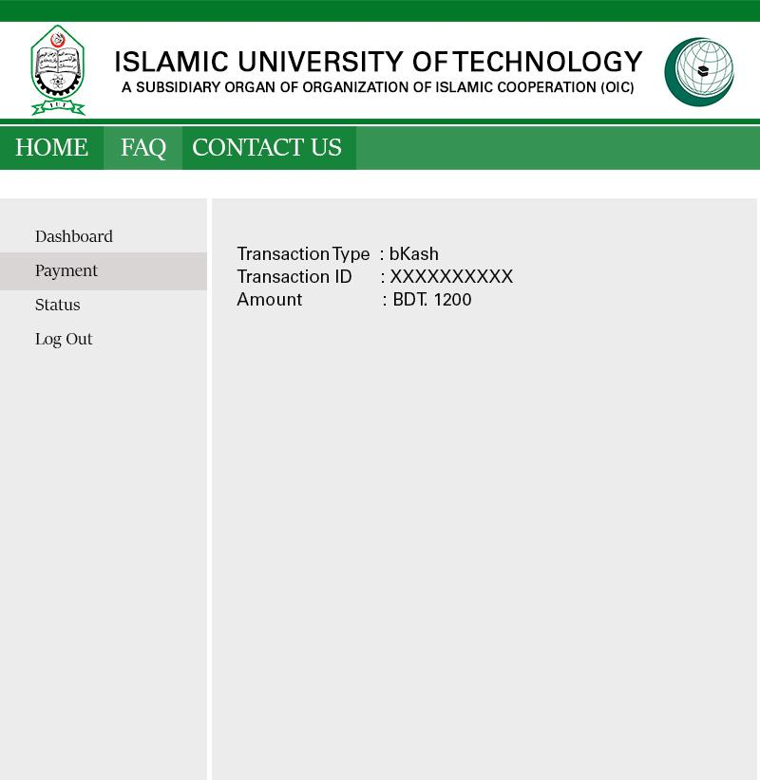
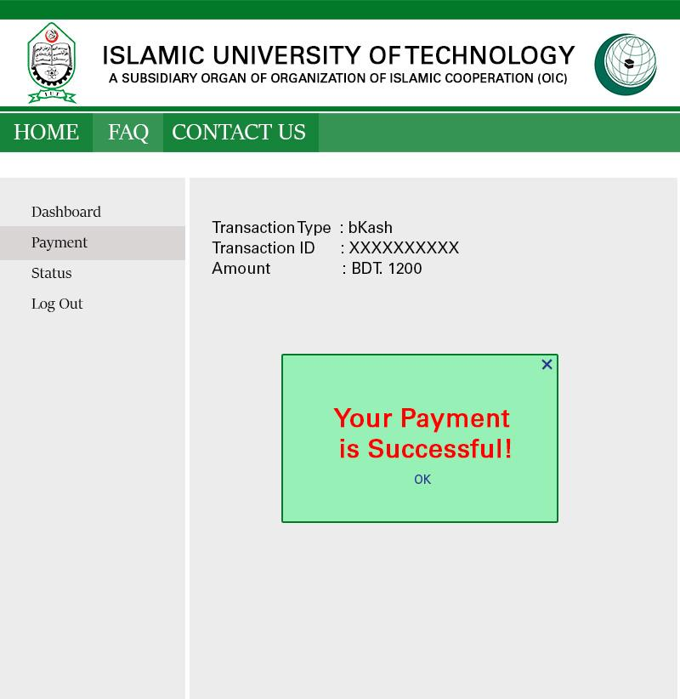

Slide 18
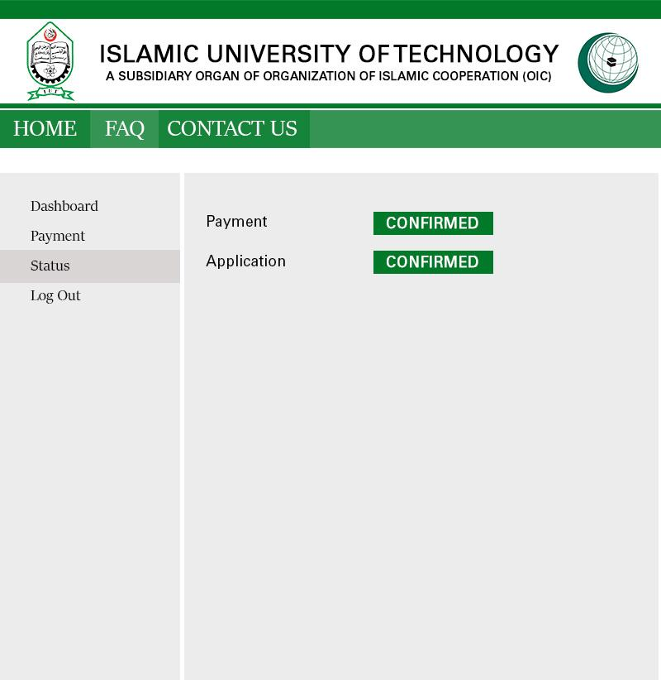

Slide 19
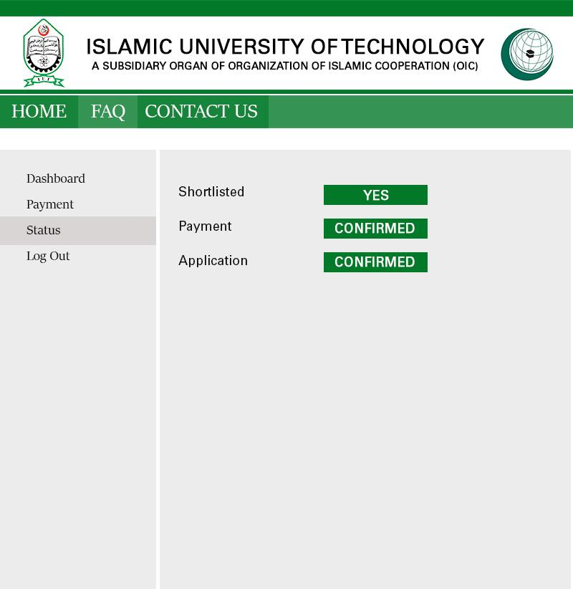

Slide 20
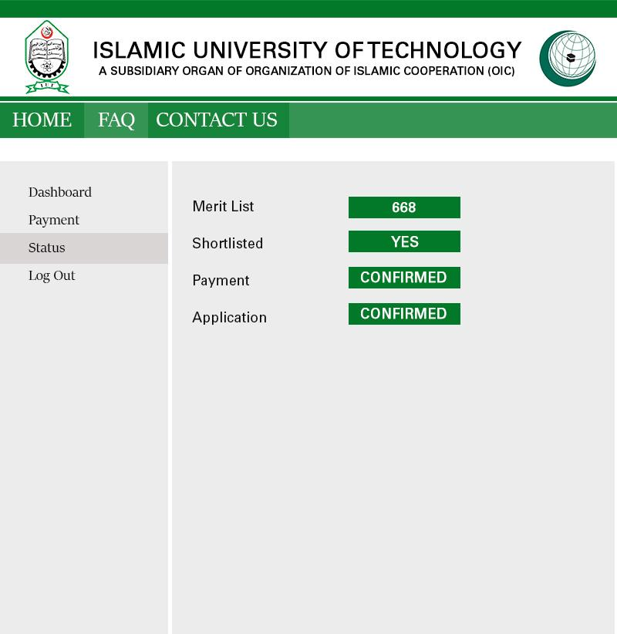

Slide 21
THANKS!
ANY QUESTIONS?

